Slide 1
Browser (Client Side) 瀏覽器 (客戶端)
DataGridView
TextBox, MsgBox
DataSet (DataTable)
DataReader
DataAdapter
1. SelectCommand
2. InsertCommand
3. UpdateCommand
4. DeleteCommand
Command
Connection
DataBase 資料庫

Slide 2
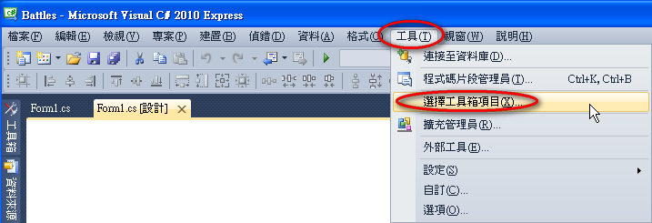
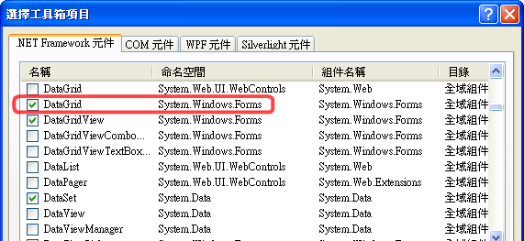

Slide 3
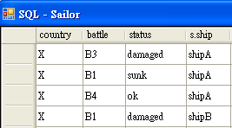
Connection ➔ DataAdapter ➔ DataSet ➔ DataGridView
using System.Data;
using System.Data.OleDb;
OleDbConnection connection1 = new OleDbConnection(
"Provider=Microsoft.Jet.OLEDB.4.0; Data Source=battles.mdb;");
connection1.Open();
OleDbDataAdapter oleDbDataAdapter1 = new OleDbDataAdapter();
DataSet ds = new DataSet();
String s = "select * from ships";
oleDbDataAdapter1.SelectCommand = new OleDbCommand (s, connection1);
oleDbDataAdapter1.Fill(ds);
1
DataGrid dataGridView1 = new DataGridView();
dataGridView1.DataSource = ds.Tables["ships"];
2
DataGrid dataGrid1 = new DataGrid();
dataGrid1.DataSource = ds;
dataGrid1.CaptionText = "Ships";

Slide 4
Connection ➔ Command ➔ DataReader ➔ TextBox
using System.Data;
using System.Data.OleDb;
OleDbConnection connection1 = new OleDbConnection(
"Provider=Microsoft.Jet.OLEDB.4.0; Data Source=battles.mdb;");
connection1.Open();
String s = "select * from ships";
OleDbCommand cmd = new OleDbCommand(s, connection1);
OleDbDataReader reader = cmd.ExecuteReader();
for(i=0; i<reader.FieldCount(); i++)
textBox1.Text += reader.GetName(i) + "\t"; // field name
textBox1.Text += Environment.NewLine;
while( reader.Read() ){ // ~fgets
for(i=0; i<reader.FieldCount(); i++)
textBox1.Text += reader.GetValue(i) + "\t"; // data
textBox1.Text += Environment.NewLine;
}
textBox1.Text = reader["country"].ToString();

Slide 5
Connection ➔ Command ➔ DataReader ➔ TextBox
using System.Data;
using System.Data.OleDb;
OleDbConnection connection1 = new OleDbConnection(
"Provider=Microsoft.Jet.OLEDB.4.0; Data Source=battles.mdb;");
connection1.Open();
String s = "insert into ships values ('A','shipA')";
OleDbCommand cmd = new OleDbCommand(s, connection1);
OleDbDataReader reader = cmd.ExecuteNonQuery();
String s = "update ships set ship='shipB' where ship='shipA'";
OleDbCommand cmd = new OleDbCommand(s, connection1);
OleDbDataReader reader = cmd.ExecuteNonQuery();
String s = "delete from ships where country='A'";
OleDbCommand cmd = new OleDbCommand(s, connection1);
OleDbDataReader reader = cmd.ExecuteNonQuery();

Slide 6
OleDbCommand cmd = connection1.CreateCommand();
try
{
cmd.CommandText = "drop table temp;";
cmd.ExecuteNonQuery();
}
catch (Exception ex)
{
}

