Slide 1
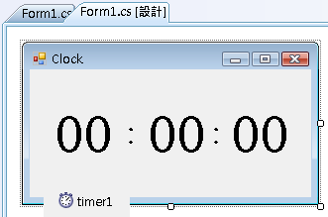
按照下表，更改各控制項Text屬性
再按F5開始偵錯 (執行)
hh : mm : ss
 | Text
form1 | Clock
(label1) lblHH | 00
(label2) lblMM | 00
(label3) lblSS | 00
label4 | :
label5 | :
timer1 | Interval 500
 | Enabled true
右按，選檢視程式碼，修改程式碼：
public partial class Form1 : Form
{
int hh=23, mm=59, ss=50;
public Form1()
{
InitializeComponent();
}
… … …
}

Slide 2
雙按 (timer1)，並加入以下程式碼：
private void timer1_Tick(object sender, EventArgs e)
{
ss++;
lblSS.Text = ss.ToString("00");
if(ss>...){...}
if(mm>...){...}
}
雙按表單 (Form1)，並加入以下程式碼：
private void Form1_Load(object sender, EventArgs e)
{
hh = 23;
mm = 59;
ss = 50;
lblHH.Text = hh.ToString("00");
lblMM.Text = mm...
lblSS.Text = ss...
}

Slide 3
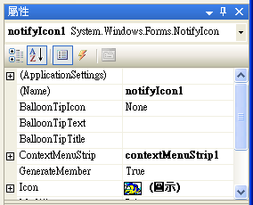
NotifyIcon
通知
notifyIcon1 | Icon =
button1 | Text = "Hide" 隠藏
Hide();

Slide 4
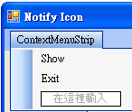
ContextMenuStrip (右按選單)
contextMenuStrip1 | Show
 | Exit
Show();
Application.Exit();
(右按)
notifyIcon1 | contextMenuStrip1
button1 | Text = "Hide"

Slide 5
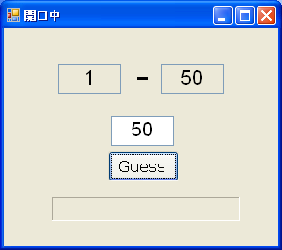
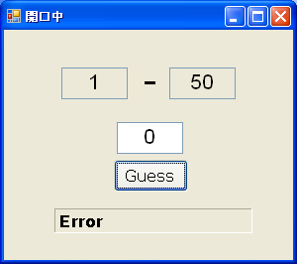
開口中 Guessing game
form1 | 開口中
textBox1,2 | min=1, max=100
label1 | -
textBox3 | guess
button1 | Guess
label2 | Error / 猜中了
label2
MinimumSize = 200
BorderStyle = Fixed3D

Slide 6
public int answer=0, min=1, max=100;
private void Form1_Load(object sender, EventArgs e)
{
Random r = new Random();
answer = r.Next(1,100);
label2.Text = answer.ToString();
label2.BorderStyle = BorderStyle.Fixed3D;
textBox1.Text = min.ToString();
textBox2.Text = max.ToString();
}
下一個隨機數
(1-100)

Slide 7
private void button1_Click(object sender, EventArgs e)
{
int guess = int.Parse(textBox3.Text);
label2.Text = "";
}
if ( ){
label2.Text = "Error";
return;
}
if ( ) label2.Text = "猜中了";
else if ( )
else
textBox1.Text = min.ToString();
textBox2.Text = max.ToString();

Slide 8
瀏覽器 Web Browser
form1 | My Web Browser
 | 800×600
webBrowser
textBox1 | http://
label1 | url
button1 | Go
若使用者
沒有輸入 http://
自動加入
webBrowser1.Navigate(textBox1.Text);
url:
http://www.hotmail.com
go

