Slide 1
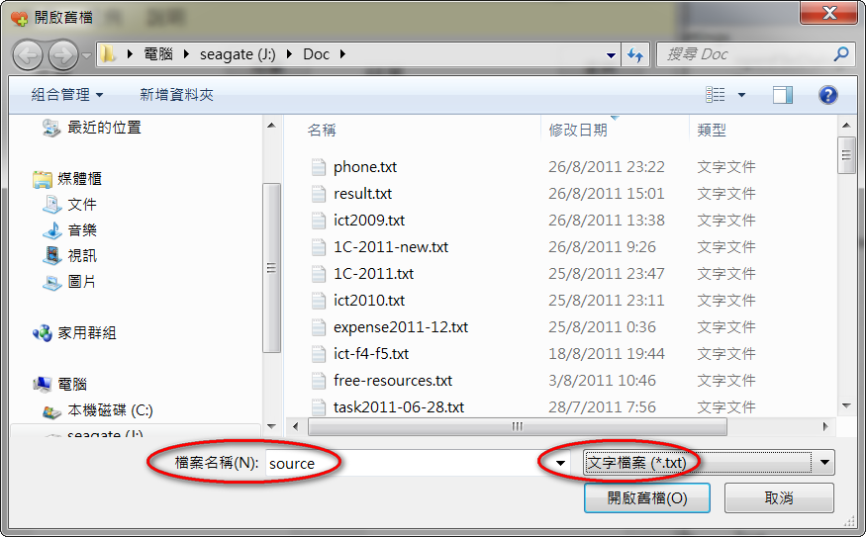
openFileDialog1.ShowDialog() 對話匣
Filter: 文字檔案 (*.txt)|*.txt|所有檔 (*.*)|*.*

Slide 2
openFileDialog1.ShowDialog()
DialogResult result = openFileDialog1.ShowDialog();
if (result == DialogResult.OK) …
if (openFileDialog1.ShowDialog() == DialogResult.OK){
}
FileInfo fp = new FileInfo( "school.txt" );
openFileDialog1.FileName
StreamReader sr = fp.OpenText(); // 開啟舊檔 “r”
// fgets
sr.Close();
string s = sr.ReadToEnd();
textBox1.Text = s;
openFileDialog1.Filter=
"文字檔案 (*.txt)|*.txt|所有檔 (*.*)|*.*";

Slide 3
saveFileDialog1.ShowDialog()
DialogResult result = saveFileDialog1.ShowDialog();
if (result == DialogResult.OK) …
if (saveFileDialog1.ShowDialog() == DialogResult.OK){
}
FileInfo fp = new FileInfo( );
saveFileDialog1.FileName
StreamWriter sw = fp.CreateText(); // 新增 “w”
// fprintf
sw.Close();
string s = textBox1.Text;
sw.Write(s);
string[] line = s.Split("\n"); // 把s變文字陣列line[]
// char line[][] = {…};

