Slide 1
http://sourceforge.net/projects/alleg/files/allegro-bin/4.2.2/
download: allegro-minGW-4.2.2.zip 6MB
Allegro 4.2.2 Game Library
allegro-minGW-4.2.2.zip 6MB
1. bin → C:\windows\system32
2. include → D:\CodeBlocks\MinGW\include
3. lib → D:\CodeBlocks\MinGW\lib
Allegro Reference
http://wiki.allegro.cc
http://www.allegro.cc/files
http://mrmcelrea.com/ComputerScience/Game%20Programming/AllegroBook.pdf
http://www.cppgameprogramming.com/cgi/nav.cgi?page=allegbasics

Slide 2
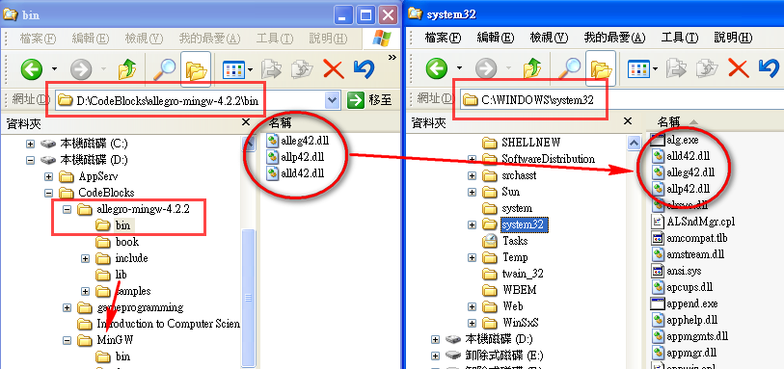
http://sourceforge.net/projects/alleg/files/allegro-bin/4.2.2/
download: allegro-minGW-4.2.2.zip 6MB

Slide 3
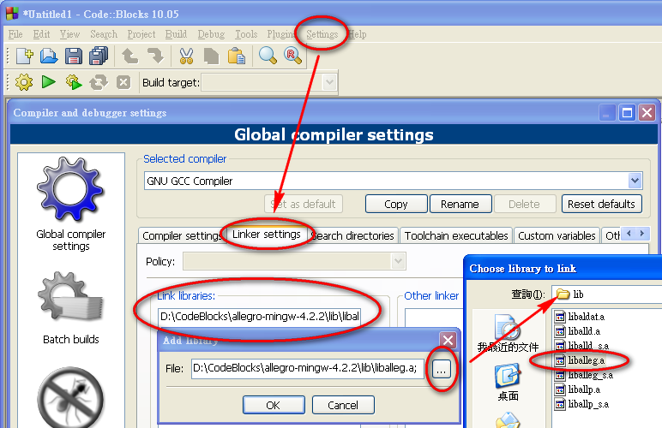
Code::Block → Settings → Compiler → Linker → Add
D:\CodeBlocks\MinGW\lib\liballeg.a
D:\CodeBlocks\MinGW\lib\liballeg.a

Slide 4
Allegro 4.2.2 Game Library
http://www.cppgameprogramming.com/cgi/nav.cgi?page=allegbasics
#include <allegro.h>
int main(){
allegro_init();
install_keyboard();
install_mouse();
set_gfx_mode ( GFX_AUTODETECT, 640, 480, 0, 0 );
readkey();
return 0;
}
END_OF_MAIN();
graphics mode
圖像模式
getch();
int black = makecol(0,0,0);
int red = makecol(255,0,0);
int green = makecol(0,255,0);
int blue = makecol(0,0,255);
setrgb(n);

Slide 5
set_gfx_mode ( GFX_AUTODETECT, 640, 480, 0, 0 );
(0, 0)
(SCREEN_W, 0)

(SCREEN_W/2, SCREEN_H/2)
(0, SCREEN_H)
(SCREEN_W, SCREEN_H)
http://mrmcelrea.com/ComputerScience/Game%20Programming/AllegroBook.pdf

Slide 6
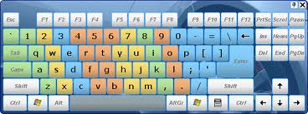
KEY_A - KEY_Z, KEY_0 - KEY_9, KEY_0_PAD - KEY_9_PAD,
KEY_F1 - KEY_F12,
KEY_ESC, KEY_TILDE, KEY_MINUS, KEY_EQUALS,
KEY_BACKSPACE, KEY_TAB, KEY_OPENBRACE, KEY_CLOSEBRACE,
KEY_ENTER, KEY_COLON, KEY_QUOTE, KEY_BACKSLASH,
KEY_BACKSLASH2, KEY_COMMA, KEY_STOP, KEY_SLASH,KEY_SPACE,
KEY_INSERT, KEY_DEL, KEY_HOME, KEY_END, KEY_PGUP,
KEY_PGDN, KEY_LEFT, KEY_RIGHT, KEY_UP, KEY_DOWN,
KEY_SLASH_PAD, KEY_ASTERISK, KEY_MINUS_PAD,
KEY_PLUS_PAD, KEY_DEL_PAD, KEY_ENTER_PAD,
KEY_PRTSCR, KEY_PAUSE,
KEY_ABNT_C1, KEY_YEN, KEY_KANA, KEY_CONVERT, KEY_NOCONVERT,
KEY_AT, KEY_CIRCUMFLEX, KEY_COLON2, KEY_KANJI,
KEY_LSHIFT, KEY_RSHIFT,
KEY_LCONTROL, KEY_RCONTROL,
KEY_ALT, KEY_ALTGR,
KEY_LWIN, KEY_RWIN, KEY_MENU,
KEY_SCRLOCK, KEY_NUMLOCK, KEY_CAPSLOCK
KEY_EQUALS_PAD, KEY_BACKQUOTE, KEY_SEMICOLON, KEY_COMMAND

Slide 7
#include <allegro.h>
#define BLACK makecol(0,0,0)
int main() {
int x=10, y=10;
allegro_init();
install_keyboard();
set_gfx_mode( GFX_AUTODETECT, 640, 480, 0, 0);
while (!key[KEY_ESC]){
clear_keybuf();
acquire_screen();
textout_ex( screen, font, " ", x, y, BLACK, BLACK );
textout_ex( screen, font, "@", x, y, RED, BLACK);
release_screen();
rest(50);
}
return 0;
}END_OF_MAIN();
#define RED makecol(255,0,0)
I/O
x+→
getch()
y+
↓
@
key
0
0
0
0
1
0
0
0
0
0
0
fflush(stdin);
if (key[KEY_UP]) y--;
else if (key[KEY_DOWN]) y++;
else if (key[KEY_RIGHT])x++;
else if (key[KEY_LEFT]) x--;
printf
_sleep

Slide 8
#include <allegro.h>
int main() {
allegro_init();
install_keyboard();
set_gfx_mode ( GFX_AUTODETECT, 640, 480, 0, 0);
acquire_screen();
release_screen();
readkey();
return 0;
}
END_OF_MAIN();
clrscr()
2. Drawing Primitives
(x1,y1)
clear_to_color ( screen, makecol( 255, 255, 255));
putpixel ( screen, 5, 5, makecol( 128, 200, 23));
circle ( screen, 20, 20, 10, makecol( 255, 0, 0));
circlefill ( screen, 50, 50, 25, makecol( 0,255, 0));
rect ( screen, 70, 70, 90, 90, makecol( 0, 0, 255));
rectfill ( screen, 100, 100, 120, 120, makecol( 12, 34, 200));
line ( screen, 130, 130, 150, 150, makecol( 255, 0, 0));
line ( screen, 130, 130, 170, 130, makecol( 255, 0, 0));
line ( screen, 170, 130, 150, 150, makecol( 255, 0, 0));
floodfill ( screen, 150, 140, makecol( 255, 255, 0));
triangle ( screen, 200, 200, 200, 220, 220, 210,
makecol( 213, 79, 40));
getch();

Slide 9
#include <allegro.h>
BITMAP *xSprite; // image or animation
BITMAP *oSprite;
int main(){
allegro_init();
install_keyboard();
set_color_depth(16);
set_gfx_mode( GFX_AUTODETECT, 640, 480, 0, 0);
xSprite = load_bitmap ( "x.bmp", NULL);
oSprite = load_bitmap ( "o.bmp", NULL);
acquire_screen();
line( screen, 200, 0, 200, 480, makecol( 255, 255, 255));
line( screen, 400, 0, 400, 480, makecol( 255, 255, 255));
line( screen, 0, 150, 680, 150, makecol( 255, 255, 255));
line( screen, 0, 300, 680, 300, makecol( 255, 255, 255));
release_screen();
readkey();
return 0;
}
END_OF_MAIN();
3. Drawing Graphics From Files
載入點陣圖
 |  | 
 |  | 
 |  | 
draw_sprite( screen, xSprite, 0, 0);
draw_sprite( screen, oSprite, 200, 0);
draw_sprite( screen, xSprite, 400, 0);
draw_sprite( screen, oSprite, 0, 150);
draw_sprite( screen, xSprite, 200, 150);
draw_sprite( screen, oSprite, 400, 150);
draw_sprite( screen, oSprite, 0, 300);
draw_sprite( screen, xSprite, 200, 300);
draw_sprite( screen, oSprite, 400, 300);
畫線
繪圖
貼上

Slide 10
4. Animation 動畫1
#include <allegro.h>
int x = 100, y = 100;
int x0 = 100, y0 = 100;
int dir = 1;
void moveCircle() {
x0 = x;
y0 = y;
if (dir == 1 && x != 20 && y != 20) {--x; --y;}
else if (dir == 2 && x != 20 && y != 460) {--x; ++y;}
else if (dir == 3 && x != 620 && y != 20) {++x; --y;}
else if (dir == 4 && x != 620 && y != 460) {++x; ++y;}
else dir = rand() % 4 + 1;
acquire_screen();
circlefill ( screen, x0, y0, 20, makecol( 0, 0, 0));
circlefill ( screen, x, y, 20, makecol( 128, 255, 0));
release_screen();
rest(10);
}
舊座標(x0,y0)
dir
1 
2 
3 
4 
清除舊圓
畫上新圓

Slide 11
Animation 動畫2
BITMAP *buffer; // temporary bitmap for double buffering
int main() {
allegro_init();
install_keyboard();
set_color_depth(16);
set_gfx_mode ( GFX_AUTODETECT, 640, 480, 0, 0);
while( !key[KEY_ESC] ) {
moveCircle();
}
}
END_OF_MAIN();
buffer = create_bitmap( 640, 480);
Double buffering 緩衝 (No flickering 閃爍)
circlefill
↓
buffer
↓
screen
circlefill ( screen, x0, y0, 20, makecol( 0, 0, 0));
circlefill ( screen, x, y, 20, makecol( 128, 255, 0));
✗✓
circlefill ( buffer, x0, y0, 20, makecol( 0, 0, 0));
circlefill ( buffer, x, y, 20, makecol( 128, 255, 0));
draw_sprite( screen, buffer, 0, 0);

Slide 12
include <allegro.h>
BITMAP* buffer;
int x = 20;
int y = 20;
void getMouseInfo() {
if (mouse_b & 1) {
x = mouse_x;
y = mouse_y;
}
}
void updateScreen() {
circlefill ( buffer, x, y, 20, makecol( 0, 0, 255));
draw_sprite( screen, buffer, 0, 0);
}
int main() {
allegro_init();
install_mouse();
install_keyboard();
set_color_depth(16);
set_gfx_mode
( GFX_AUTODETECT, 640, 480, 0, 0);
buffer = create_bitmap( 640, 480);
show_mouse (buffer);
while( !key[KEY_ESC]) {
getMouseInfo(); // x=?, y=?
updateScreen();
}
return 0;
}
END_OF_MAIN();
Mouse
Left button | mouse_b & 1
Right button | mouse_b & 2
Wheel | mouse_b & 3

Slide 13
press arrow keys to draw lines
x+→
#include <allegro.h>
#define BLACK makecol(0,0,0)
#define WHITE makecol(255,255,255)
y+
↓
int main(){
int x,y;
allegro_init();
install_keyboard();
set_color_depth(16);
int ret = set_gfx_mode (GFX_AUTODETECT_FULLSCREEN, 1280, 1024, 0, 0);
x=y=100;
textout_ex ( screen, font, "press arrow keys", x, y, WHITE, BLACK);
…
}
if(ret!=0){
allegro_message ("could not set video mode");
allegro_exit();
return;
}
printf

Slide 14
x+→
y+
↓
main(){
…
x=y=100;
textout_ex ( screen, font, "press arrow keys", x, y, WHITE, BLACK);
while (!key[KEY_ESC]){
putpixel (screen, x, y, makecol (255,255,0));
rest(5);
}
release_screen();
allegro_exit();
return 0;
}
END_OF_MAIN()
if (key[KEY_UP]) y--;
if (key[KEY_DOWN]) y++;
if (key[KEY_LEFT]) x--;
if (key[KEY_RIGHT]) x++;
畫點

Slide 15
BITMAP *image
#include <allegro.h>
int main() {
BITMAP *image;
int x,y;
allegro_init();
install_keyboard();
set_color_depth(16);
int ret = set_gfx_mode (GFX_AUTODETECT_WINDOWED, 800, 600, 0, 0);
if (ret != 0){
allegro_message ("could not set video mode");
allegro_exit();
return 1;
}
release_screen();
allegro_exit();
return 1;
}
END_OF_MAIN()
image = load_bitmap ("wizard.bmp", NULL);
x++; y++;
draw_sprite (screen, image, x, y);

Slide 16
int main() {
BITMAP *image;
image = load_bitmap ("wizard.bmp", NULL);
if (image == NULL){
allegro_message ("could not load the wizard image");
allegro_exit();
}
BITMAP *buffer = create_bitmap (SCREEN_W, SCREEN_H);
x=y=500;
while (!key[KEY_ESC]){
draw_sprite (screen, image, x, y);
rest(5);
}
destroy_bitmap(image);
if (key[KEY_UP]) y--;
if (key[KEY_DOWN]) y++;
if (key[KEY_LEFT]) x--;
if (key[KEY_RIGHT])x++;
// place image at (x,y)
draw_sprite (buffer, image, x, y);
draw_sprite (screen, buffer, 0, 0);
clear_bitmap (buffer);
} END_OF_MAIN()

Slide 17
BITMAP *dragon
#include <allegro.h>
#define WHITE makecol(255,255,255)
#define BLACK makecol(0,0,0)
int main() {
BITMAP *dragon;
int x, y;
allegro_init(); install_keyboard(); set_color_depth(16);
set_gfx_mode (GFX_AUTODETECT_WINDOWED, 640, 480, 0, 0);
儲存圖像資料
解像度
色深
textprintf (screen, font, 0, 0, WHITE,
"Resolution = %ix%i", SCREEN_W, SCREEN_H);
textprintf (screen, font, 0, 10, WHITE,
"Color depth = %i", bitmap_color_depth(screen));
dragon = load_bitmap ("spacedragon1.bmp", NULL);
x = SCREEN_W/2 - dragon->w/2;
y = SCREEN_H/2 - dragon->h/2;
while … …
destroy_bitmap (dragon);
載入圖像
中心位置
移動 dragon
} END_OF_MAIN();

Slide 18
dragon->w
BITMAP *dragon;
(x, y)
dragon = load_bitmap ("spacedragon1.bmp", NULL);
x = SCREEN_W/2 - dragon->w/2;
y = SCREEN_H/2 - dragon->h/2;
while (!key[KEY_ESC]){
//erase the sprite
rectfill (screen, x, y, x+dragon->w, y+dragon->h, BLACK);
x--; // move left
draw_sprite (screen, dragon, x, y);
textprintf (screen, font, 0, 20, WHITE, "Location = %ix%i", x, y);
rest(10);
}
destroy_bitmap (dragon);
dragon->h
if (x< 2) x = SCREEN_W - dragon->w; // back on the right
x,y 位置

Slide 19
#include <allegro.h>
void main(void) {
SAMPLE *sample;
int panning = 128, pitch = 1000, volume = 128;
allegro_init();
install_keyboard();
set_gfx_mode (GFX_AUTODETECT_WINDOWED, 640, 480, 0, 0);
Sound (clapping.wav)
//install a digital sound driver
if (install_sound (DIGI_AUTODETECT, MIDI_NONE, "") != 0) return;
sample = load_sample ("clapping.wav");
if (!sample) return;
play_sample (sample, volume, panning, pitch, TRUE);
readkey();
destroy_sample (sample);
remove_sound();
return;
}
END_OF_MAIN();

